Slide 1
The Rules of the Digital Playground

Slide 2
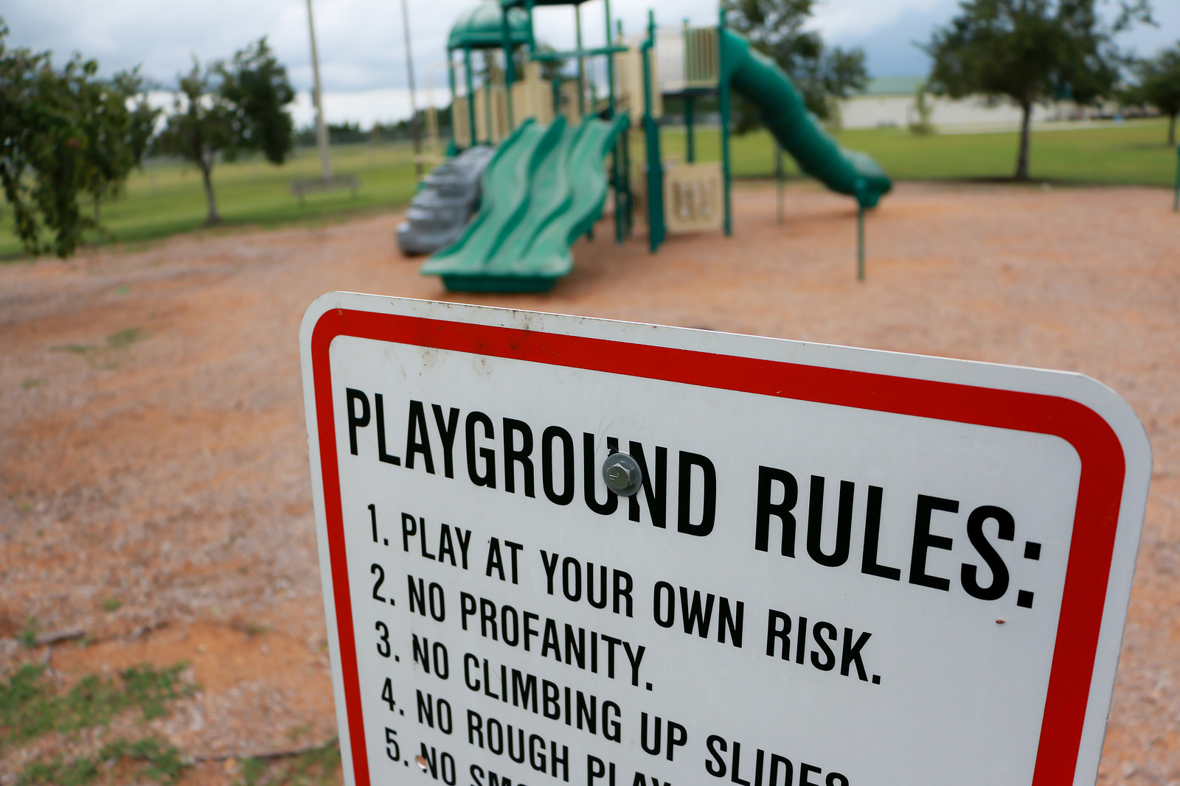
The Rules of the Digital Playground
Guiding Question: How can rules and policies keep me safe on the digital playground of the internet in the same way rules keep me safe on the actual playground?
Students will:
Understand that policies and laws help keep people safe online, just like rules help on a playground.
Identify examples of age-appropriate online rules and policies.

Slide 3
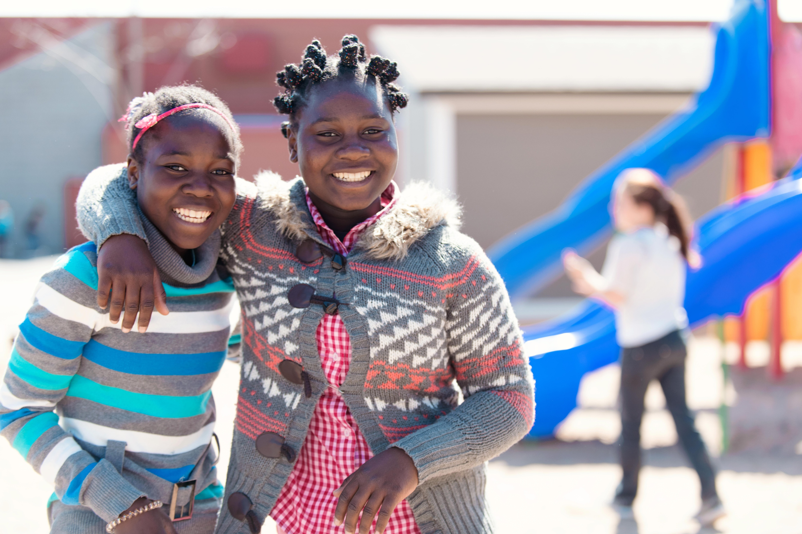
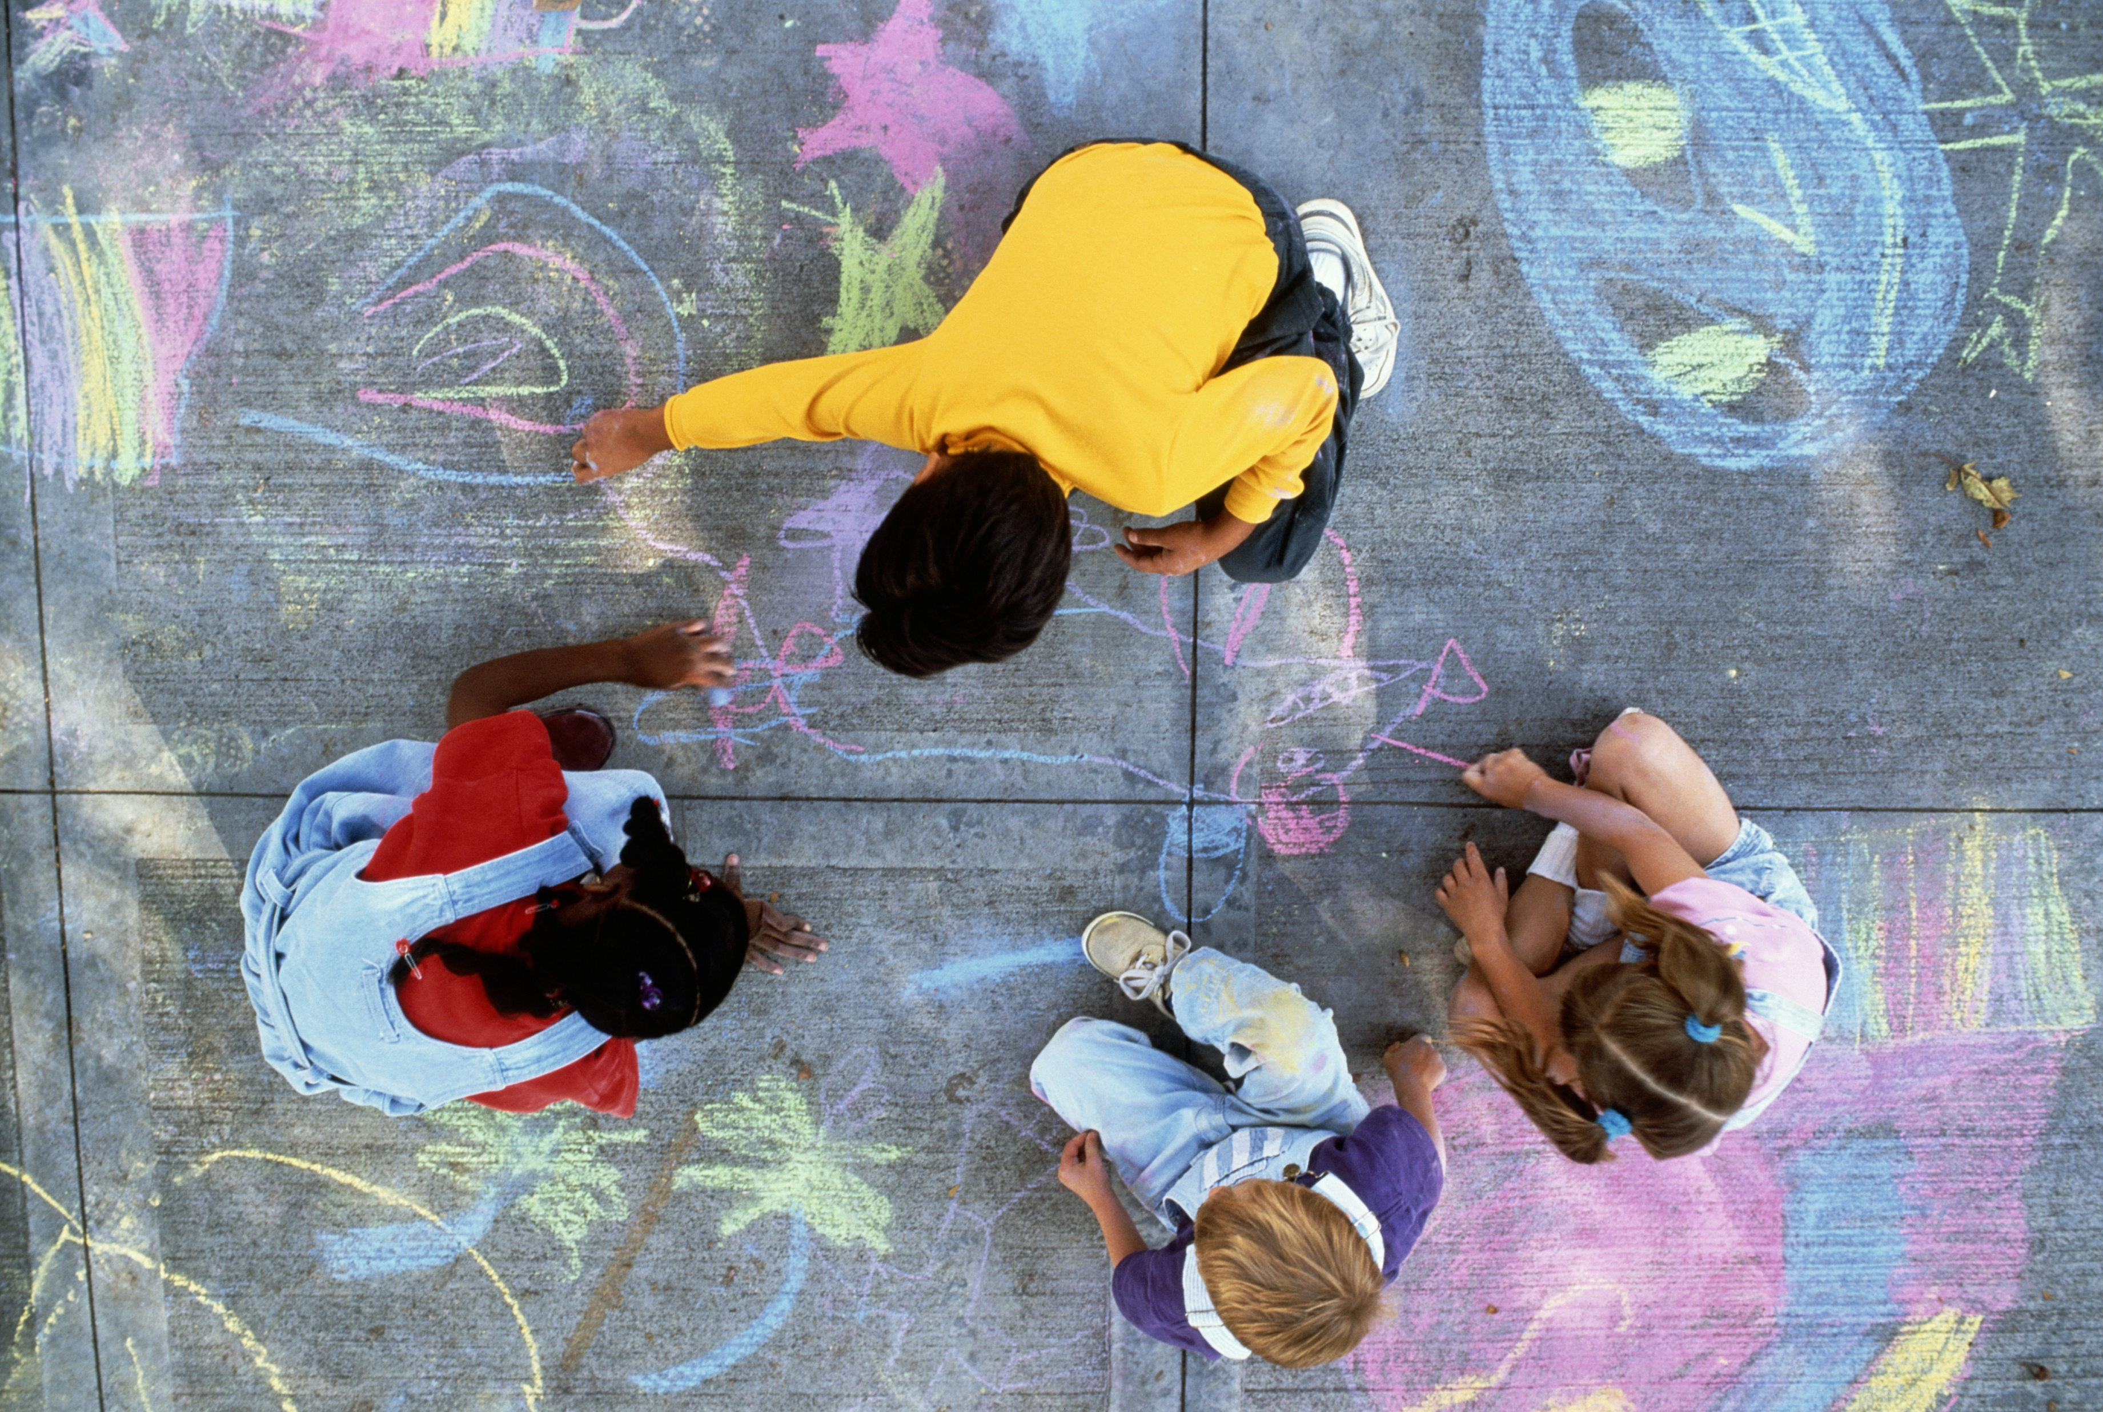
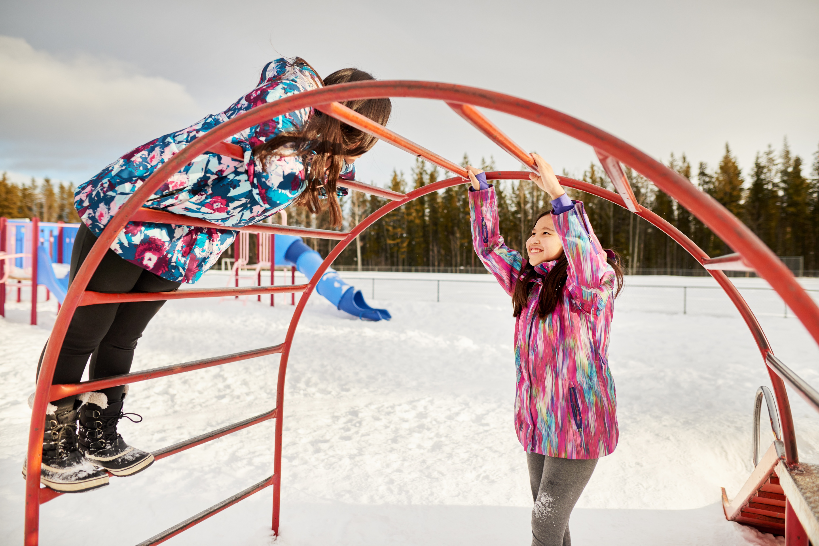
The Rules to Safely Play
What are the rules for our playground/outdoor space/commons area?
Why do you think these rules exist?
What happens if you break the rules for our playground/outdoor space/commons area?
The internet has rules too, and breaking those rules can lead to consequences!

Slide 4
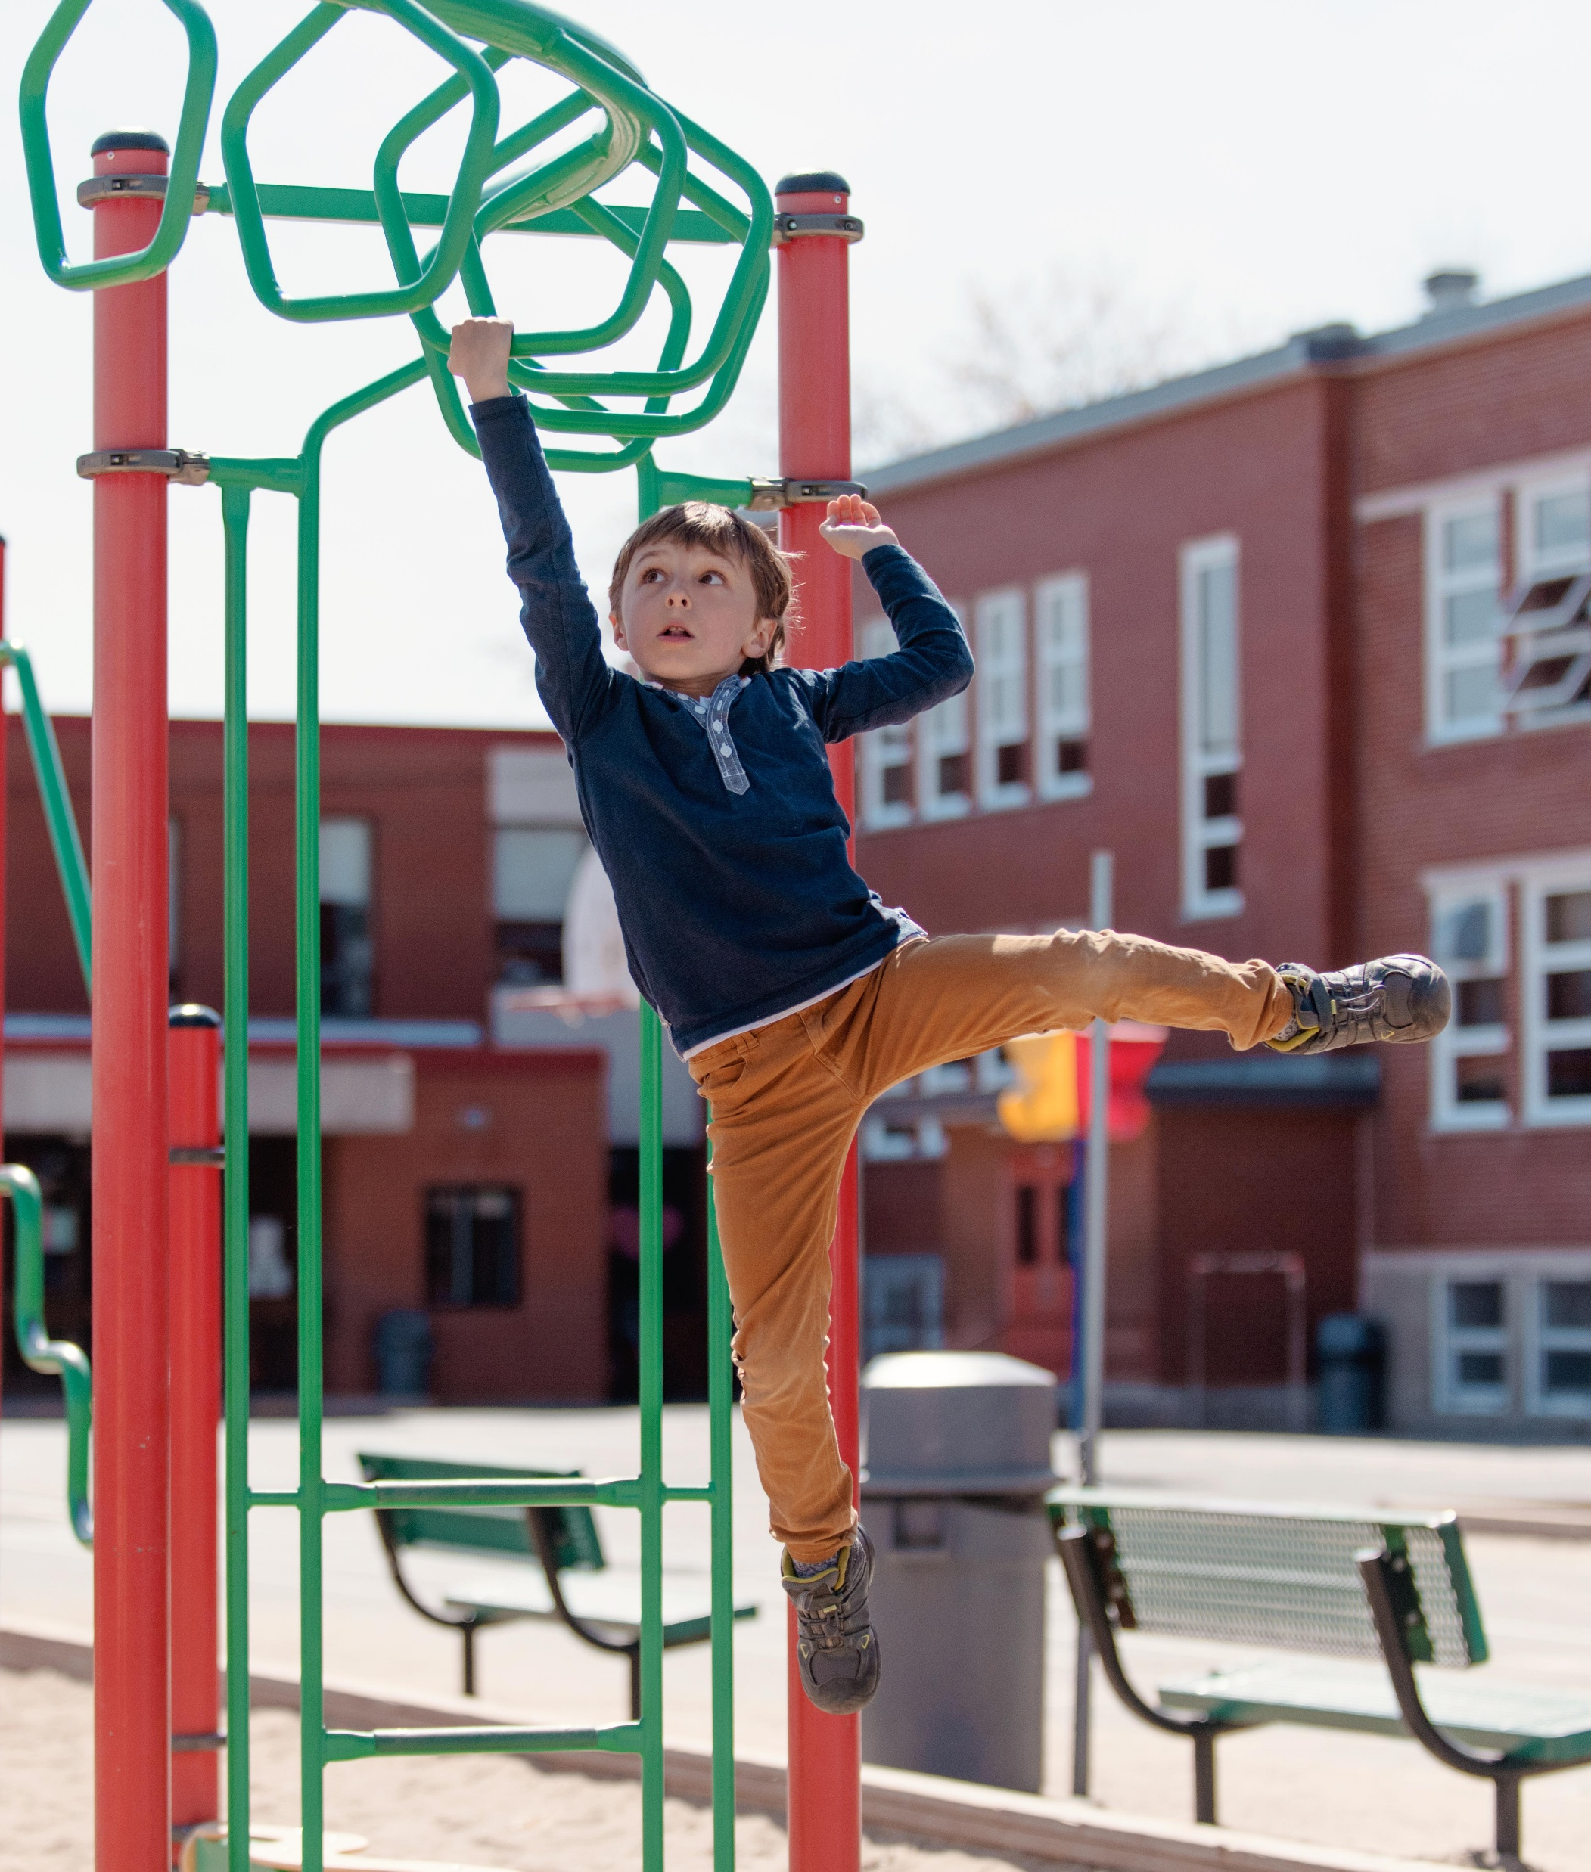
The Case of the Digital Playground
Alex loves spending time on the playground at school. Alex knows all the playground rules and does his best to play safely while on the playground. One day, a classmate mentions a cool new game app. Alex is excited to play but quickly realizes that the internet has its own set of rules – just like the playground.

Slide 5
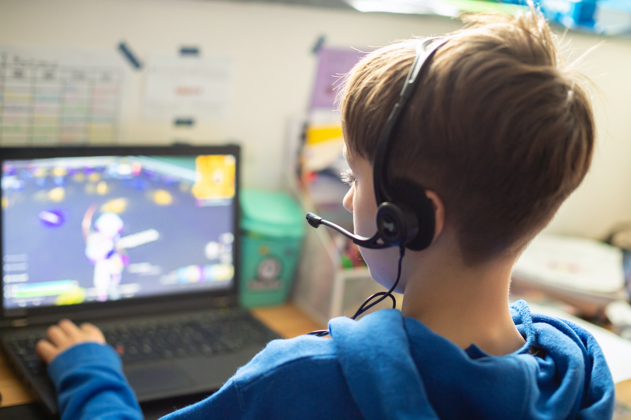
Rule Number 1: Age Restrictions
Alex tries to sign up for the new game app, but a pop-up says, “You must be 13 or older to create an account.” Alex is only 10. “Why can’t I sign up?” Alex wonders.
Why do you think the app has age restrictions?
How might this rule keep Alex safe?
Age restrictions protect younger users from content and interactions they might not understand or be ready for.

Slide 6
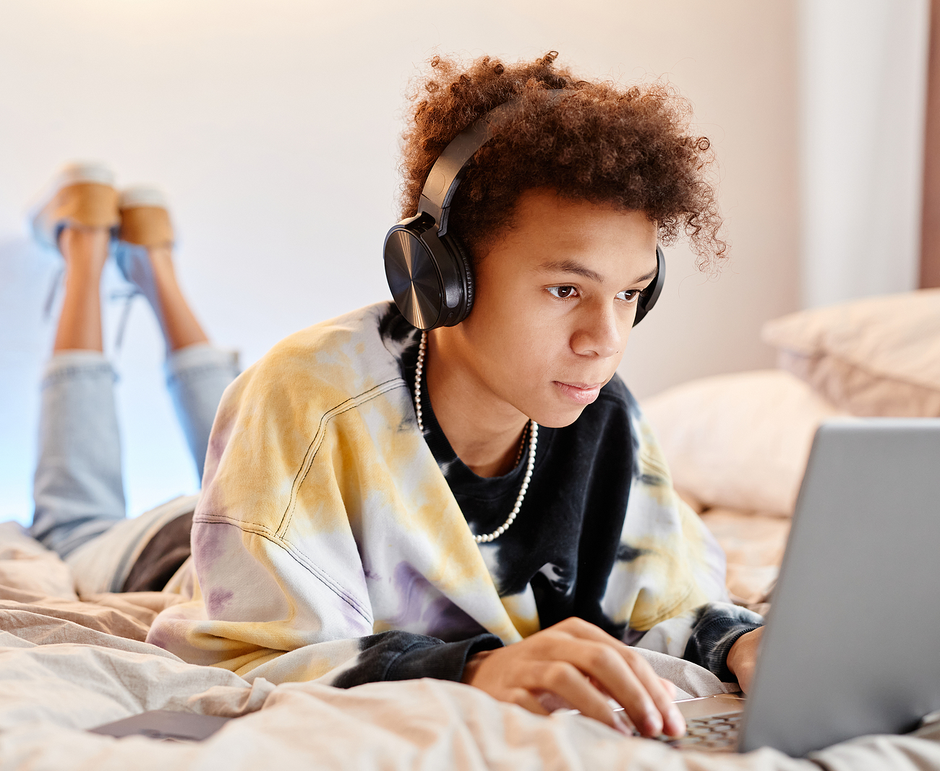
Rule 2: Reporting Unkind Behavior
Alex finally finds a different game app that’s for kids. While playing, Alex sees another player sending mean messages to everyone in the chat. Instead of replying, Alex clicks the “Report” button and tells a parent.
What should Alex do if the behavior continues?
Why do you think games have a “Report” button?
Reporting tools help stop harmful behavior and keep online spaces safe and respectful.

Slide 7

Rule 3: Privacy Settings
While playing the game, Alex decides to share a fun picture of the family’s new puppy. Later, a stranger comments, “Cute dog! What’s its name?” Alex gets a little nervous and realizes his profile is set to “Public.” With a parent’s help, Alex changes the settings to “Friends Only.”
What could happen if Alex didn’t change the privacy settings?
How do privacy settings protect your personal information?
Privacy setting control who sees your information and can protect you from sharing too much online.

Slide 8

Knowledge Check
By following these online rules, Alex enjoys the game safely and learns how to make smart decisions online!
What are some of the similarities we are seeing in our playground rules versus the rules Alex is discovering about the internet?
Alex ran into a rule restricting him from creating an account at a game website because of his age. What could be a rule for the playground/outdoor space/commons area here at our school? How would it keep students safe?

Slide 9

Online Rule I Have, Who Has Game
Students will partner up with one I Have, Who Has card.
One partner will read the I Have portion when appropriate, the other will read the Who Has when appropriate.
Teacher will select one partnership to read their WHO HAS portion of their card first.
The game ends when everyone has read their portions of every card, and the partner of the first reader reads the I Have portion of the first card read!

Slide 10


Cyber Career Spotlight

Slide 11
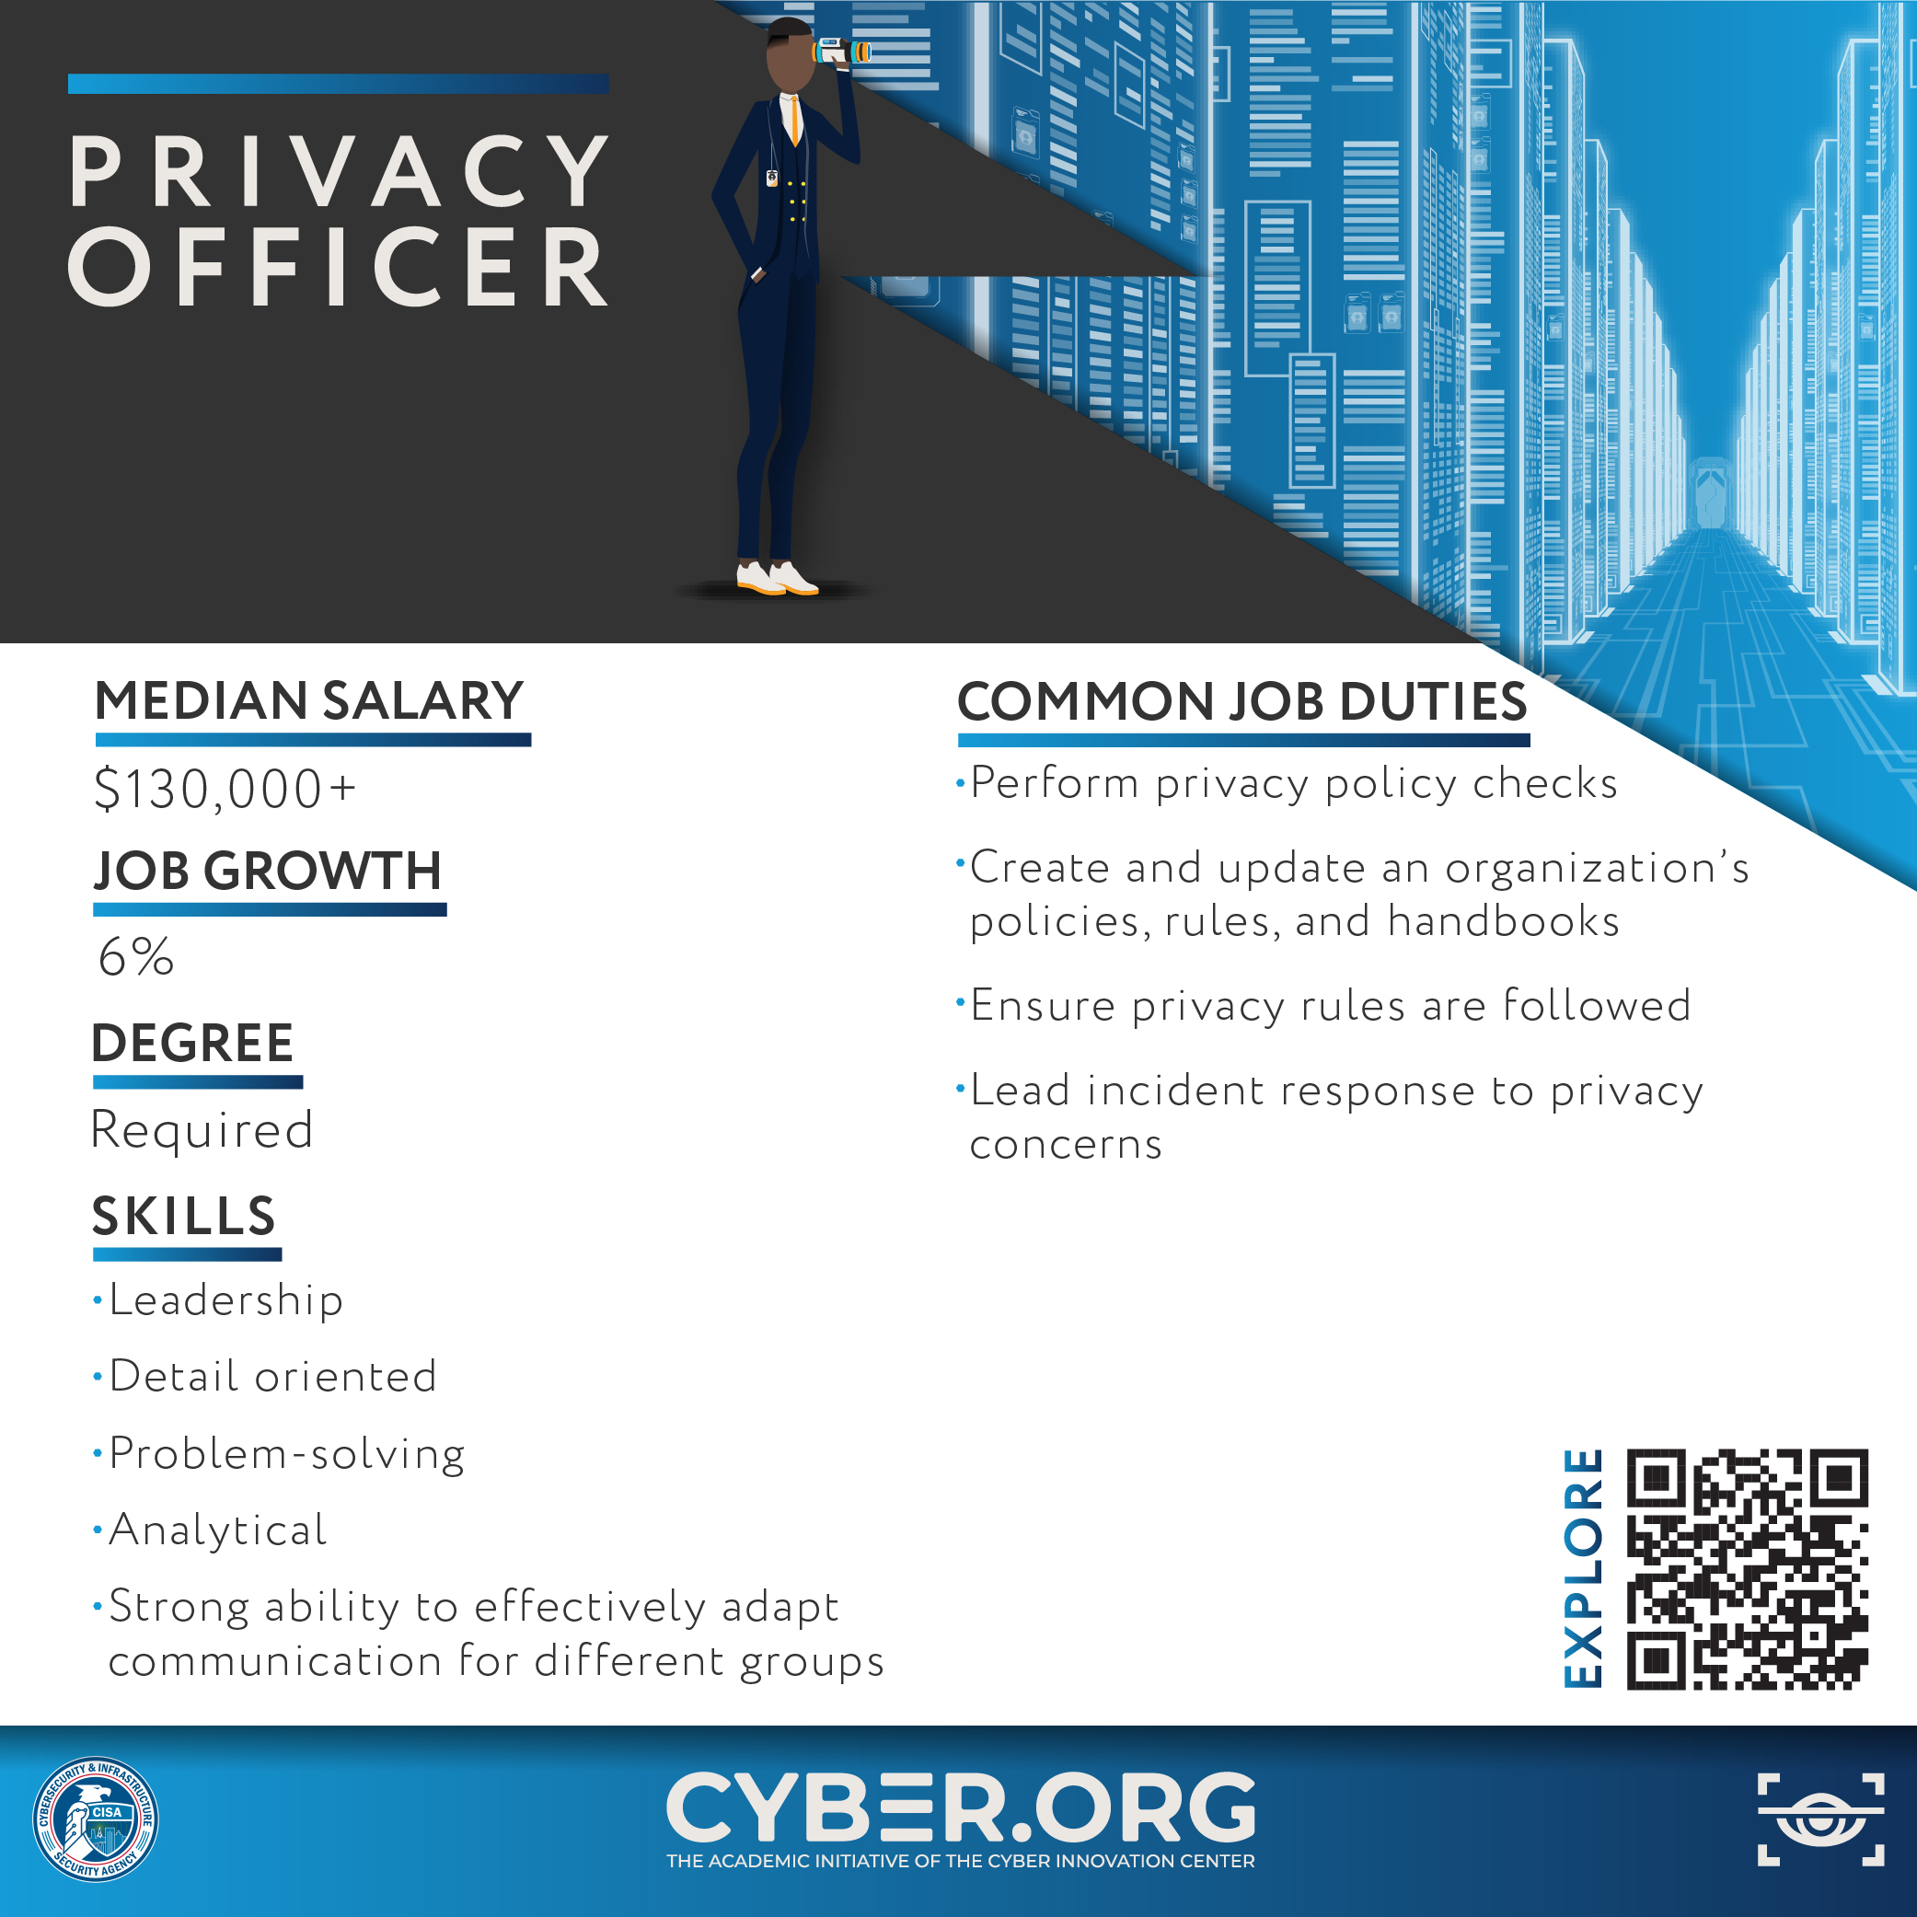
Cyber Career Spotlight Details

Slide 12
Putting It All Together
What is one online rule you think is really important? Why?
How do you think these rules make the internet safer for everyone?
Exit Ticket: What is one thing you learned today and one rule you think everyone should follow online?

